Slide 1





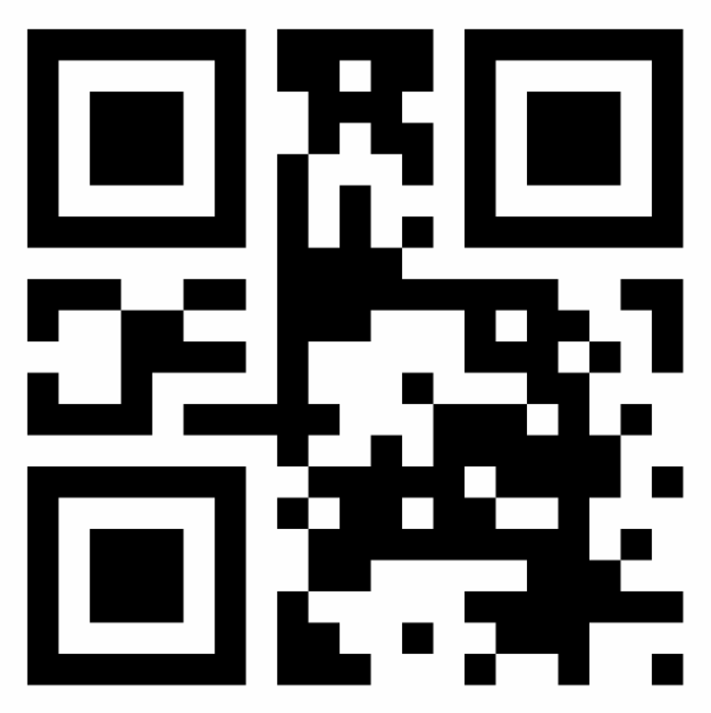





3P sticker verifier
Verifiers are systems that verify stickers issued by 3rd parties (3Ps). They can be mobile apps used by 3P staff or can be physical check-points. They verify stickers' authenticity with the issuer’s public key, verify stickers’ ownership by matching users’ face hash with the hash stored in the stickers, and decode the content of stickers for 3P staff to read it. Verifiers rely on Trust Graphs to cache trusted 3P public keys in advance, allowing them to run sticker verifications even while offline.
1
On a check-point, 3rd Party (3P) staff ask users to show the 3P sticker containing their entitlement to a service or area. 3P staff may carry a portable device running a 3P verifier app, or users can reach a physical check-point with or without staff (e.g., kiosks, check-in desks, and gates).
When users scan their 3P sticker, verifiers lookup the issuer’s domain to extract their public key and verify the authenticity of the sticker’s signature, and to verify if the sticker’s issuer is trusted to mark users’ verifiable credentials as “verified”.
To allow sticker signatures to be validated offline, validators keep a cache of trusted 3P public keys, and they periodically export public keys from a trust graph.
3P staff then ask users to scan their face biometrics, either by taking a picture of the user’s face using the portable device, or by scanning users’ faces using a camera attached to the check-point’s hardware.
Verifiers calculate users’ face hash on the fly using the same open source algorithm used by wallets to calculate users’ face hash on wallet registration. Because the wallet hash is passed down to 3P stickers, verifiers can verify the ownership of the sticker by comparing the face hash on a sticker with the hash they just calculated.
On their user interface (UI), 3P staff confirms the signature’s authenticity, scan users faces, and view sticker data (e.g., birth day, verified credentials, metadata).
If the face hash validation fails, then 3P staff may verify the stickers ownership by comparing the birth day on the 3P sticker with the birth date in a user’s document.
2
Trust Graph
User interface (UI)
1
6
export
JP Air. [3P] Sticker
VALID
SIGN
Birth day:
May, 14th
Verified info:
Passport
3rd dose vaccine
Wheelchair
Metadata:
Flight: BA501
Date: 02/11/22
Motor wheelchair
Expires: 10/01/22
3P staff
Scan face
3P sticker verifier
3
3
2
verify 3P signature
get key
Export request
7
S
authorities [domain],
codes [code]
trusted 3P public keys
4
3P sticker
Export response
verify face hash
page,
total pages,
domains [
domain,
codes [ code ],
public key
]
4
face
User
trust stamp
algorithm
5
5
3P verifier app
3P verifier in physical check-point
trust stamp
algorithm
trust stamp
algorithm
user interface
trusted 3P public keys
trusted 3P public keys
6
Trust Graph
user interface
API
Trust Graph
7

